Slide 1
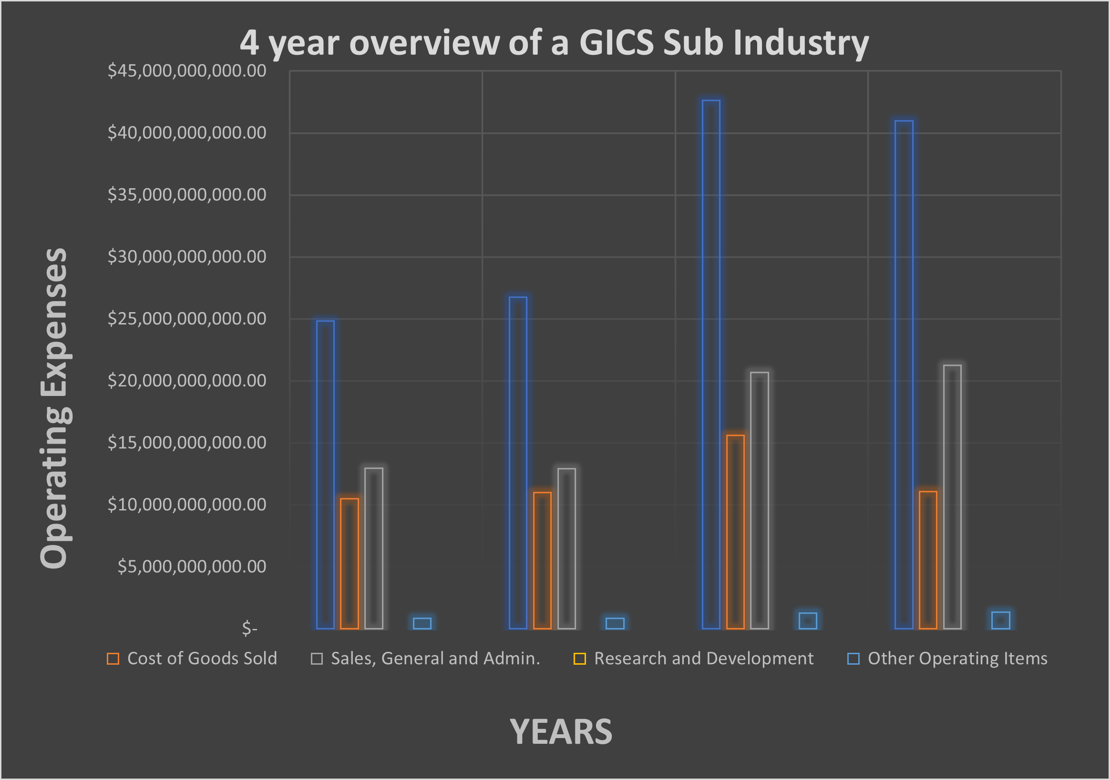
Does reseach and development affect your cost of goods sold?
As one of the biggest Airlines, American Airlines does not document they finance research and development based on information for www.gurufocus.com.
In this chart, I have demonstrated that the cost of goods sold have not been affected. The drastic things to noted is the costs of theother operating items.

